Slide 1

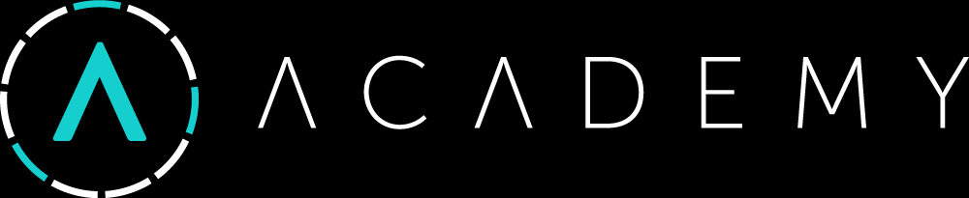
Building a Blockchain
Building a Node (Peers + Blocks + Transactions), Wallet App, Miners, Faucet, Block Explorer
Svetlin Nakov
Blockchain Trainer
Academy School of Blockchain
http://kingsland.academy

Slide 2
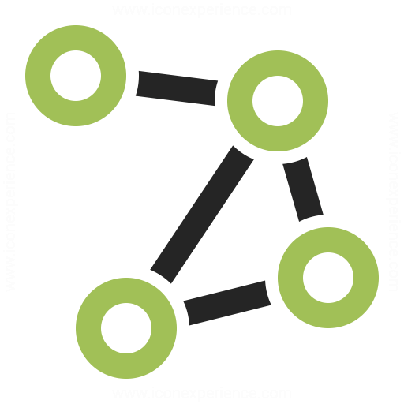

Table of Contents
Building a Blockchain Node
Peers, Blocks, Transactions, Addresses, Balances
Designing the REST API
Blockchain System Architecture
Building the Mining Software
Building a Faucet App
Building a Wallet App
Building an Block Explorer Site

Slide 3
Blockchain System Architecture
Node
Node
Miner
Node
Wallet
Block Explorer
Faucet
Nodes, Miners, Faucet, Wallets, Explorer

Slide 4
Blockchain System Architecture
Node
Wallet
Block Explorer
Peers
Blocks
Transactions
Balances
Mining Jobs
Keep private keys
Check balances
Send transactions
View blocks
View confirmed transactions
View pending transactions
View accounts and balances
View peers map
Miner
Faucet
Get block hash
Mine (PoW)
Submit result
Request 5 coins

Slide 5
Building the Blockchain Node
Peers, Blocks, Transactions, Addresses, Balances, Designing the REST API

Slide 6
Building the Blockchain Node: Node
Node
Peers: URL[]
Blocks: Block[]
PendingTransactions: Transaction[]
Balances: map(address => number)
Difficulty: number
MiningJobs: map(address => Block)

Slide 7
Building the Blockchain Node: Block
Block
Index: number
Transactions: Transaction[]
Difficulty: number
PrevBlockHash: hex_number
MinedBy: address
BlockDataHash: address
Nonce: number
DateCreated: timestamp
BlockHash: hex_number

Slide 8
Building the Blockchain Node: Transaction
Transaction
From: address
To: address
Value: number
SenderPubKey: hex_number
SenderSignature: hex_number[2]
TransactionHash: hex_number
DateReceived: timestamp
MinedInBlockIndex: number
Paid: bool

Slide 9
Keys and Addresses
ECDSA, using the secp256k1 curve
private key
public key
address
256-bit number
{x, y} - 256-bit numbers
compressed: {x, 0/1}
65 hex digits
RIPEMD-160 of the compressed public key)
40 hex digits
64 hex digits
9279fa6a314fb0728f7cfd93669cf7f35cc01b6389fd220664919f455b307203
4d86d765fb03805c97e5042c91ee0cd31646adbe47aecacb39ddd1d546bc63cd1
5d845cddcd440fb304ecf7122d5476fd6b1cf0e5

Slide 10
REST Endpoints: Info
GET
http://{host}:5555/info
{
"about": "SoftUniChain/0.9-csharp",
"nodeName": "Sofia-01",
"peers": 2,
"blocks": 25,
"confirmedTransactions": 208,
"pendingTransactions": 7,
"addresses": 12,
"coins": 18000000
}
200 OK

Slide 11
REST Endpoints: Blocks
GET
http://{host}:5555/blocks
[ {
"index": 17,
"transactions": […],
"difficulty": 5,
"prevBlockHash": "d279fa6a31ae4fb07cfd9cf7f35cc01f…3cf20a",
"minedBy": "f582d57711a618e69d588ce93895d749858fa95b",
"blockDataHash": "5d845cddcd4404ecfd5476fd6b1cf0e5…a80cd3",
"nonce": 2455432,
"dateCreated": "2018-02-01T23:23:56.337Z",
"blockHash": "00000abf2f3d86d5c000c0aa7a425a6a4a65…cf4c"
}, {…}, {…}, …]
200 OK

Slide 12
REST Endpoints: Block Number
GET
http://{host}:5555/blocks/11
{
"index": 11,
"transactions": […],
"difficulty": 4,
"prevBlockHash": "e69cb1368aa174c9e5548f4e5adb0d3b4c6c…ef25",
"minedBy": "494cd91ac8f7d97487dc7e05fc3463358126fa73",
"blockDataHash": "5d845cddcd4404ecfd5476fd6b1cf0e5…a80cd3",
"nonce": 2455432,
"dateCreated": "2018-02-01T22:58:23.129Z",
"blockHash": "d2c6ee29ff14b49e31c409af985824ea12afccc8…e4cd"
}
200 OK / 404 Not Found

Slide 13
REST Endpoints: Get Balance
GET
http://{host}:5555/balance/44fe…2a75/confirmations/6
{
"address": "44fe0696beb6e24541cc0e8728276c9ec3af2a75",
"confirmedBalance": {"confirmations": 8, "balance": 120.00},
"lastMinedBalance": {"confirmations": 1, "balance": 115.00},
"pendingBalance": {"confirmations": 0, "balance": 170.20}
}
200 OK / 404 Not Found

Slide 14
REST Endpoints: Send Transaction
POST
http://{host}:5555/transactions/new
{
"from": "44fe0696beb6e24541cc0e8728276c9ec3af2675",
"to": "9a9f082f37270ff54c5ca4204a0e4da6951fe917",
"value": 25.00,
"senderPubKey": "2a1d79fb8743d0a4a8501e0028079bcf82a4f…eae1",
"senderSignature": [e20c…a3c29d3370f79f, cf92…0acd0c132ffe56]
}
201 Created / 400 Bad Request
{
"dateReceived": "2018-02-01T23:17:02.744Z",
"transactionHash": "cd8d9a345bb208c6f9b8acd6b8eefe6…20c8a" }

Slide 15
REST Endpoints: Get Transaction Info
GET
http://{host}:5555/transactions/44fe…2a75/info
200 OK / 404 Not Found
{
"from": "44fe0696beb6e24541cc0e8728276c9ec3af2675",
"to": "9a9f082f37270ff54c5ca4204a0e4da6951fe917",
"value": 25.00,
"senderPubKey": "2a1d79fb8743d0a4a8501e0028079bcf82a4f…eae1",
"senderSignature": [e20c…a3c29d3370f79f, cf92…0acd0c132ffe56]
"transactionHash": "4dfc3e0ef89ed603ed54e47435a18b836b…176a"
"paid": true,
"dateReceived": "2018-02-01T07:47:51.982Z",
"minedInBlockIndex": 7
}

Slide 16
REST Endpoints: Notify About New Block
POST
http://{host}:5555/blocks/notify
{
"index": 51
}
200 OK
{
"message": "Thank you"
}

Slide 17
REST Endpoints: List All Peers
GET
http://{host}:5555/peers
200 OK / 409 Conflict
[
"http://212.50.11.109:5555",
"http://af6c7a.ngrok.org:5555"
]

Slide 18
REST Endpoints: Connect Peer
POST
http://{host}:5555/peers
{
"url": "http://212.50.11.109:5555"
}
200 OK / 409 Conflict
{
"message": "Added peer …"
}

Slide 19
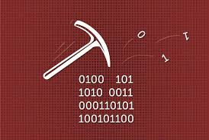
Mining Software
Proof-of-Work Mining

Slide 20
Building the Mining Software: Get Block
GET
http://{host}:5555/mining/get-block/f582d577…fa95b
{
"index": 50,
"transactionsIncluded": 17,
"expectedReward": 62.25,
"blockDataHash": "d2c6ee29ff14b499af985824ea12afccc8…e4cd",
}
200 OK / 400 Bad Request

Slide 21
Building the Mining Software: Submit Block
POST
http://{host}:5555/mining/submit-block/f582d577…fa95b
{
"nonce": 426436537,
"dateCreated": "2018-02-01T07:47:51.982Z",
"blockHash": "00000abf2f3d86d5c000c0aa7a425a6a4a65…cf4c"
}
{
"status": "accepted",
"message": "Block accepted, expected reward: 63.58 coins"
}
200 OK / 400 Bad Request

Slide 22
Faucet App

Slide 23
Faucet App

Slide 24
Wallet App

Slide 25
Wallet App

Slide 26
Block Explorer

Slide 27
Block Explorer

Slide 28
Building a Blockchain
http://www.kingsland.academy

